Slide 1




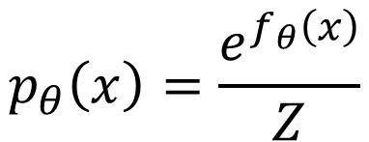
…
$$f_{θ}\left(x\right)$$
$$e^{f_{θ}\left(x\right)}$$
$$p_{θ}\left(x\right)=\frac{e^{f_{θ}\left(x\right)}}{Z}$$
…
positive
normalize
$$x$$
Generative Model

